Slide 1
AMOD 5420H/ COIS 4350H
High Performance Computing

Slide 2
Instructor: Sri
Instructor: Brian Srivastava
Email Address: bsrivastava@trentu.ca
Phone Number: 705-748-1011 x7092
Office: OC 102.9
Office Hours: TBA

Slide 3
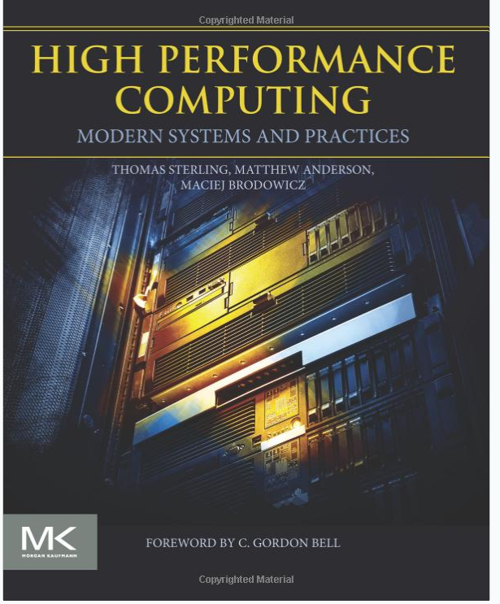
Textbook: Yes
High Performance Computing, Modern Systems and Practices 1st Edition, Authors: Thomas Sterling Matthew Anderson Maciej Brodowicz
Notes:
C. Gordon bell developed VAX when at DEC, helped found Microsoft research and is the person who classified computers into types (embedded, cluster, workstation etc)

Slide 4
Assignments
Assignment 1: 10% Benchmarking, writing HPC code sept 24 (probably not until the week after)
Assignment 2: 10% Open MP Due Oct 22nd
Assignment 3: 10% MPI Due Nov 12
Assignment 4: 10% Parallel Algorithms Due Nov 26
Project: Final exam

Slide 5
Labs
Weekly Tech: experimentation/discussion (1% per) 10%, probably there won’t be much at the end of the course for the last week
Labs are different between the two courses (though related)
Some of the labs are going to be really easy… when they work, and a nightmare if they don’t. That’s why I do labs

Slide 6
Project
Research Project: 20% Due at the final exam… ish)
For CS students this is more likely to be something related to how to build/administer/manage a cluster, whereas for AMOD students I expect it to be more subject matter driven (e.g. a financial simulation or weather modelling or something)

Slide 7
Exam
The final exam will be scheduled during the regular exam period, students are expected to be available for the whole exam period.
Religious accommodation for the exam needs to be arranged with uh.. Early Note that I’m expecting to need both an in person and remote exam

Slide 8
Grade Total by Withdrawal Date:
Students will have approximately 5 labs, 2 assignments graded by the withdrawal deadline; these total to 35% of a student’s final grade.
The final date to withdraw from this course is whenever it is

Slide 9
Topics
Introduction
HPC Architecture
Commodity Clusters
Benchmarking
The Essential Moab
SMP
The Essential OpenMP
The Essential MPI
Parallel Algorithms
Libraries
Operating Systems
Scientific Visualization
Performance Monitoring
Debugging
Accelerators
Essential OpenACC
Mass Storage
File Systems
Map Reduce
Checkpointing
Beyond (Next Steps)

Slide 10
Introduction

Slide 11
Basic problems to think about
Hardware (both racked systems and the network interconnects, how are they unique in an HPC application vs server farm vs gaming PC)
Operating systems (How is Linux different from Linux?)
Numerical Methods on a cluster?
Data structures + Algorithms (parallel, distributed)
Mass storage – How do you store (literally) 15000 TB of data using 12 TB drives?

Slide 12
Course Overview
Anatomy of a Supercomputer
Supercomputing – Empowering Exploration
Performance – Oriented Theme
Where does performance come from?
Sources of performance degradation
Supercomputer System Stack
A Brief History of HPC
Enabling technologies
Fundamental Concepts
Accomplishments in HPC

Slide 13
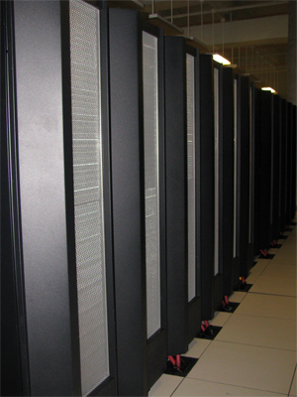
Learning Outcomes
Define supercomputer
Describe performance Issues in HPC
Define scalability
List machine parameters affecting performance and describe how they impact operation
Describe driving factors for HPC
Describe sources of performance degradation
Describe supercomputing system stack
Understand the evolution and drivers of the 7 decade history of HPC

Slide 14
Biggest Computer in the US - Supercomputer
The TITAN petaflops machine fully deployed at Oak Ridge National Laboratory in 2013. It takes up more than 4000 square feet and consumes approximately 8 Megawatts of electrical power. It has a theoretical peak performance of over 27 Petaflops and delivers 17.6 Petaflops R_{max} sustained performance for the HPL (Linpack) benchmark. This architecture includes Nvidia GPU accelerators.

Slide 15
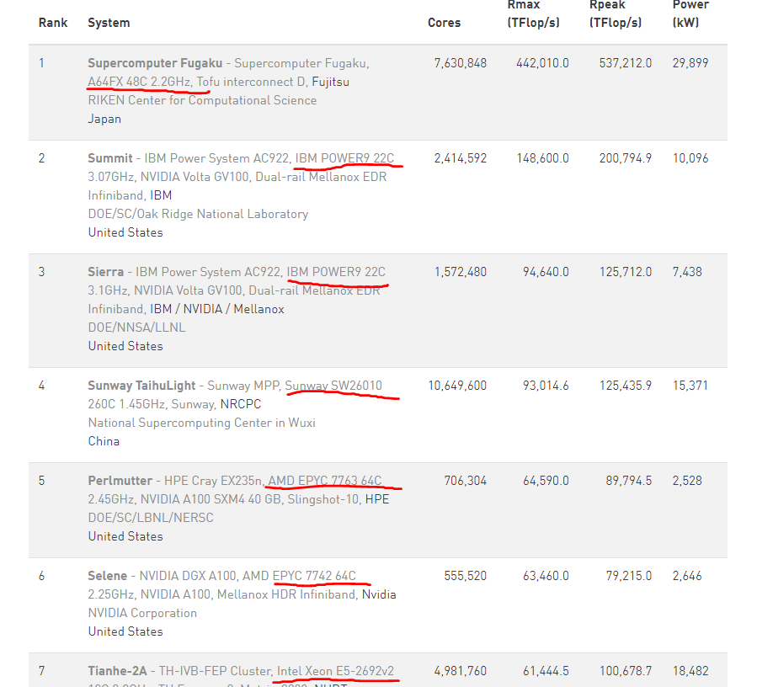
Top 500 June 2021 (For sept 2021)
https://www.top500.org/lists/top500/2021/06/
I highlighted the CPUs 2 are IBM power, 2 are essentially custom, 3 are AMD/Intel

Slide 16
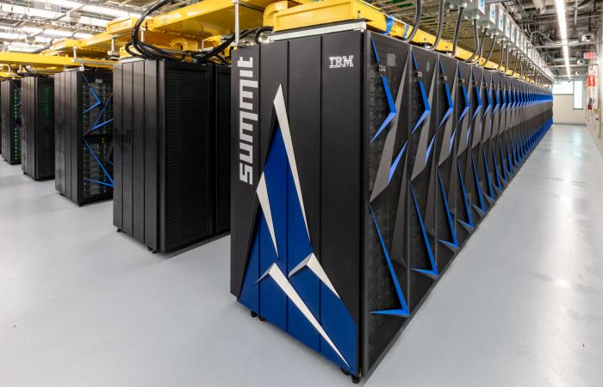
Summit
Notes:
https://www.ornl.gov/news/ornl-launches-summit-supercomputer

Slide 17
Addressing the Big Questions
What grand challenge applications demand these capabilities?
How do users program such systems?
What languages and in what environments?
What are the semantics and strategies?
How to manage supercomputer resources to deliver useful computing capabilities?
What are the hardware mechanisms?
What are the software policies?
What are the computational models and algorithms that can map the innate application properties to the physical medium of the machine?
How to integrate enabling technologies into computing engines?
How to push the performance to extremes?
What are the enabling conditions?
What are the inhibiting factors?

Slide 18
Goals of the Course
A first overview of the entire field of HPC
Basic concepts that govern the capability and effectiveness of supercomputers
Techniques and methods for applying HPC systems
Tools and environments that facilitate effective application of supercomputers
Hands-on experience with widely used systems and software
Performance measurement methods, benchmarks, and metrics
Practical real-world knowledge about the HPC community
Accessible by students outside the HPC mainstream

Slide 19
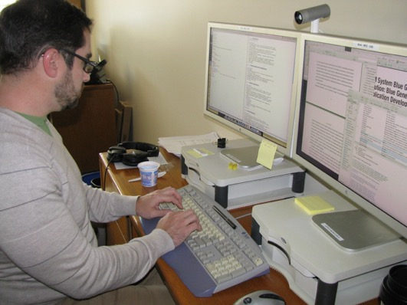
Student Objectives
Computational Scientists
How to use supercomputer
Apply to domain applications
HPC research
Foundations of supercomputing
Research directions
System Administration
Making them serve the user base
Managing multi-billion dollar systems
Design Engineering
Challenges to building supercomputers
What are their enabling technologies
Functional components

Slide 20
Course Overview: Major Topic Areas
Introduction to Supercomputer Systems, Supercomputing, and Technologies
Distributed Memory Systems and MPI Programming
Shared Memory Systems and OpenMP Programming
Performance Modeling and Measurement for Performance Optimization
User Environments: System Software and Tools
Enhanced Techniques for System Use
Conclusions and Future Directions

Slide 21
Course Overview: First Pass Introduction
An Overview
What’s it all about
How you can take advantage of it
Parallel Computer Architecture
What are supercomputers
Commodity Clusters
The most widely used form of HPC systems
So easy you can build one yourself; many do
Benchmarking
Finding out how good your system is compared to others
Throughput Computing
The easiest way to use HPC systems
“Embarrassingly parallel”

Slide 22
Course Overview: Distributed Memory and MPI Programming
Communicating Sequential Processes (CSP)
Abstract model of computing across distributed
Enabling Technologies – Networks for Node Integration
Making a big supercomputer out of smaller computers
Communications, data movement, and messaging
MPI Programming
Most widely used programming interface
True scalable computing
Suitable for current generation supercomputers
Performance Measurement
What do we want to make better
Units of measure for system operation
Some methods for instrumentation

Slide 23
Course Overview: Shared Memory Systems and OpenMP Programming
Single Node Architecture
Every thing you need to compute in one box
Enabling Technologies – Memory, Core Architectures,..
Basic component types and their underlying technologies
Parallel Thread Computing
The abstract execution model for shared memory multiple threads
OpenMP programming
Widely used parallel programming interface
Incremental changes to sequential applications
Performance factors and measurement
Parameters that determine the capabilities of shared memory systems

Slide 24
Course Overview: System Software
Operating Systems
Low level software for hardware resource management
Memory management and address allocation
Processor core schedulers for application threads and processes
I/O interfaces
Schedulers and Middleware
Medium level software that controls system wide resources
Controls user jobs and total system workload
Provides system administration tools
Parallel File I/O
Supports persistent storage for disks and tapes (sometimes NVRAM)
Exploits multiple disks for higher bandwidth and reliaiblity

Slide 25
Course Overview: Advanced Methods
Visualization
Software to render raw output data in a form that is visually informative
Many distinct types of visual data presentation in 2-D and 3-D
Parallel Algorithms
Abstract patterns of computation that achieve desired computation results (correct answers) and exposes and exploits parallelism
HPC Libraries
Prepackaged functions that already provide frequently used algorithms
Simplifies and expedites creation of new HPC applications
Heterogeneous Computing and GPUs
Systems comprising different types of functional units
In some cases accelerates computations compared to homogeneous

Slide 26
Course Overview: Final Topics and Future Directions for you and HPC
What’s beyond the scope of this course?
What form will the future of HPC take?

Slide 27
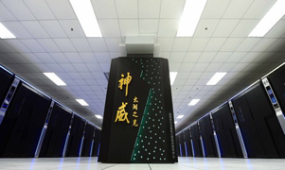
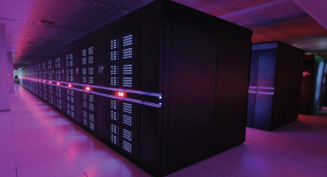
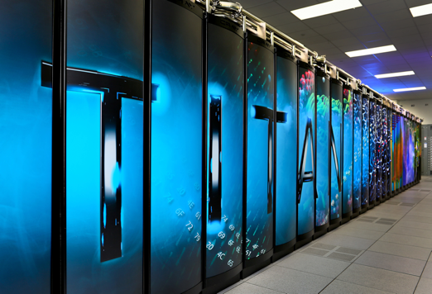
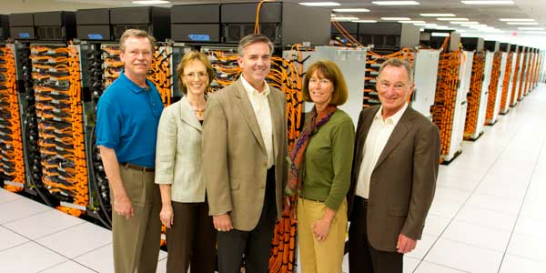
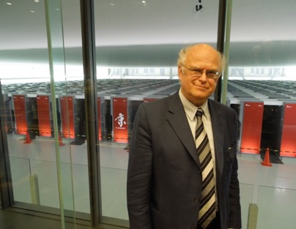
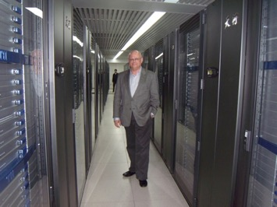
Recent #1 Supercomputers
Taihulight
93 Pflops
Tianhe-2
33.9 Pflops
Titan
17.59 Pflops
Sequoia
16.32 Pflops
Kei
10.5 Pflops
Tianhe-1A
2.56 Pflops

Slide 28
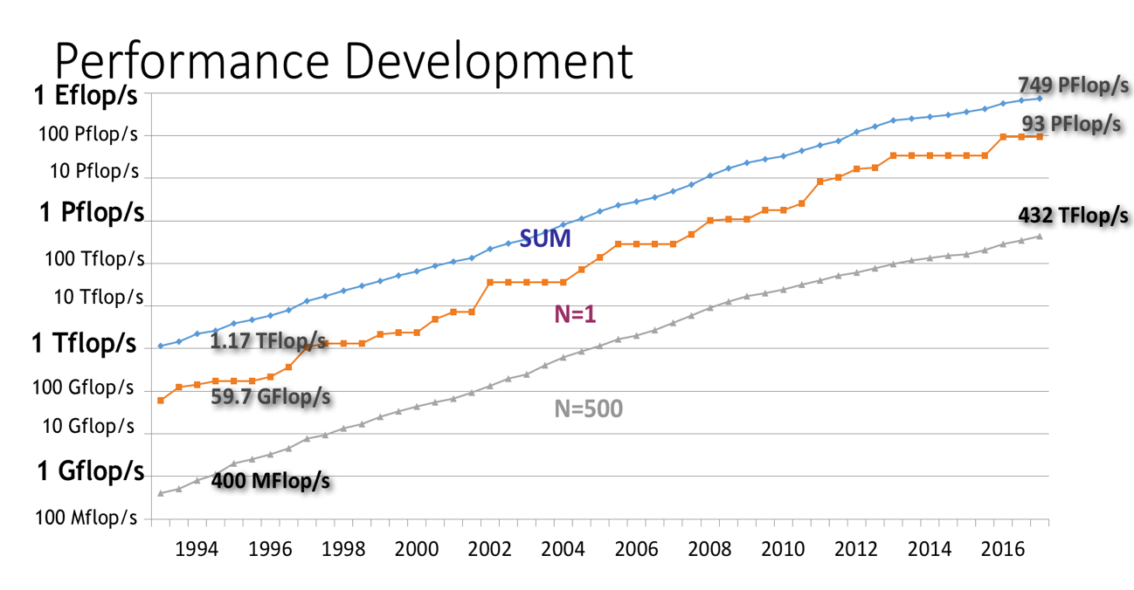
The evolution of the R_{max} from the HPL benchmark for supercomputing systems in the Top 500 list since the beginning of the list in 1993. Blue (top line) indicates the cumulative performance of all the computers in the list. Red (middle line) shows the performance of the #1 computer in the list. Orange (bottom line) shows the performance of the #500 computer in the list.

Slide 29
Definitions: Supercomputer
Supercomputer: A computing system exhibiting high-end performance capabilities and resource capacities within practical constraints of technology, cost, power, and reliability.
– Thomas Sterling, 2007
Supercomputer: A large very fast mainframe used especially for scientific computations.
– Merriam-Webster Online
Supercomputer: Any of a class of extremely powerful computers. The term is commonly applied to the fastest high-performance systems available at any given time. Such computers are used primarily for scientific and engineering work requiring exceedingly high-speed computations.
– Encyclopedia Britannica Online

Slide 30
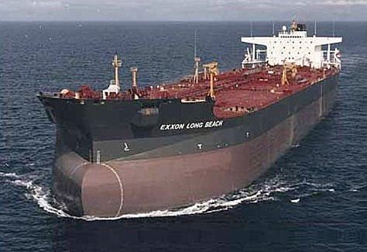
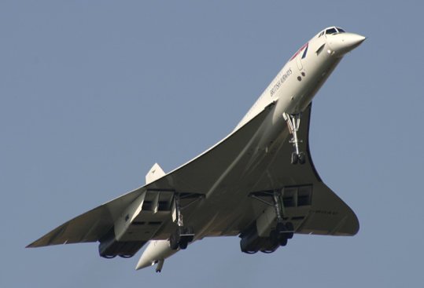
HPC Modalities
Capacity Computing
Also referred to as “throughput computing”
Job stream parallelism: a form of weak scaling
No interrelationship between independent tasks
No inter-synchronization, No data exchange
Performance measured by total floats across jobs normalized to time
Capability Computing
Single job, fixed-size data set: strong scaling
Tightly coupled, strong interrelationship among parallel actions
Performance achieved through reduction of time to solution
“Cooperative Computing”
Single job, weak scaling: problem data set expands to fill scaled up systems
Coordinated via shared synchronization
Cooperative through exchange of intermediate result values
Capability – floats. Numericals – cpu (l4) slides

Slide 31
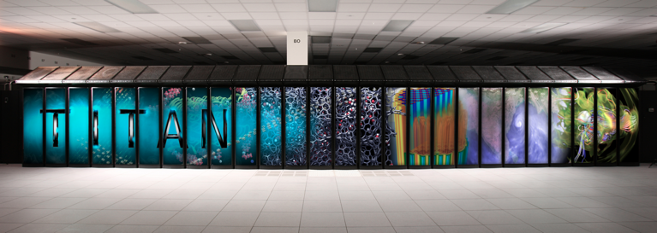
HPC Examples
Tianhe-2
55 Petaflops peak performance
33.9 Petaflops Linpack Rmax
1,375 Terabytes memory
Intel Xeon Phi Accelerator
24 Mwatts power
NUDT deployed
Inspur manufacturer
Titan
27 Petaflops peak performance
17.5 Petaflops Linpack Rmax
693 Terabytes memory
NVIDIA Tesla Accelerator GPU
8.2 MWatts power
ORNL deployed
Cray manufacturer

Slide 32
Conventional Heterogeneous Multicore System Architecture
Global Interconnection Network
NIC
Accelerator
Core Array
Multicore Sockets
…
Scratchpad memory
Memory Banks
Node 2
Node 3
Node N
Node 1

Slide 33
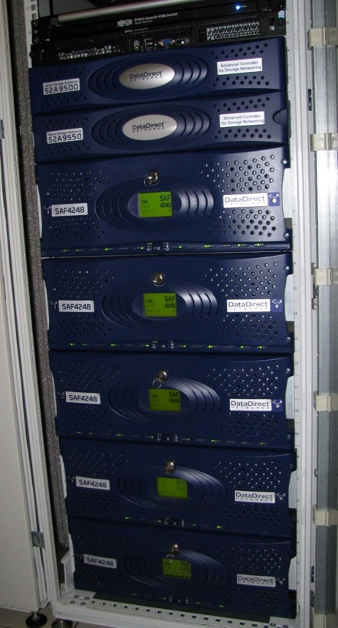
Machine Parameters Affecting Performance
Peak floating point performance
Main memory capacity
Bi-section bandwidth
I/O bandwidth
Secondary storage capacity
Organization
Class of system
# nodes
# processors per node
Accelerators
Network topology
Control strategy
MIMD
Vector, PVP
SIMD
SPMD

Slide 34
Titan Specifications
Performance
Peak: 27 Petaflops
HPL: 17.59 Petaflops
Storage Capacity
Memory: 710 Terabytes
2ndary: 10 Petabytes
Physical
# racks: 200 cabinets
Floor space: 4,452 sq. feet
Power: 8.2 Megawatts
Cost: $97M Architecture
Cray XK7
CPU: AMD Opteron 6274
16 cores
GPU: Nvidia Tesla K20X
2,496 Cuda cores
732 MHz clock
Node: 1 CPU + 1 GPU
18,688 total
2 nodes per blade

Slide 35
Supercomputing System Stack
Applications
End user problems, often in sciences and technology
Algorithms
Numerical techniques
Means of exposing parallelism
Programming
Languages, tools, & environments
Compilers and runtime software
Maps application program to system resources, mechanisms, and semantics
Operating systems
Manages resources and provides virtual machine
Computer architecture
Semantics and structures
Device technologies
Enabling technologies for logic, memory, & communication
Circuit design

Slide 36
Productivity
Collaborative Workflows
Execution Model
Applications
Resilience
Workflow
Management
Programming Environment Tools & Libraries
Programming Model
Languages
Parallel Semantics
Object Abstraction
Energy
Runtime
Systems
User Threads
Global Address Space
Synchronization
Communication
Introspection
Operating
System
System-Wide OS
I/O Object Storage Software
Lightweight Kernel
LWK
LWK
. . .
LWK
System
Hardware
PM
PM
PM
. . .
PM
Persistent Storage
Processor Cores (P)
Memories (M)
Networks
The system stack of a general supercomputer consists of a system hardware layer and several software layers. The first of the software layers is the operating system encompassing both resource management and middleware to access I/O channels. Higher software layers include runtime systems and workflow management.

Slide 37
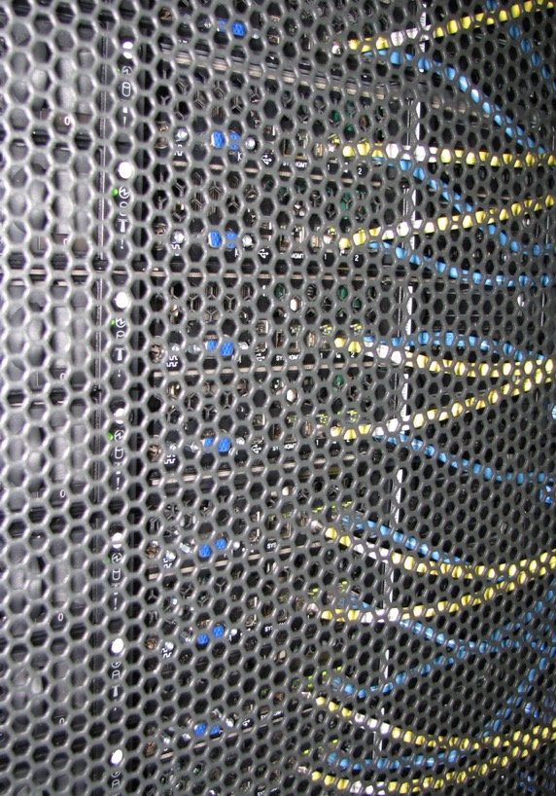
Programming Models and Interfaces
Sequential
Fortran
C
C++
Capacity/Throughput
Job stream parallelism
Condor
Moab
Cooperative
Communicating Sequential Processing
MPI
Capability
Shared memory, multiple threads
OpenMP
Cilk++

Slide 38
Supercomputing Problem Representatives | Academia | Industry | Government
Solution of Partial Differential Equations | Navier-Stokes equations, Einstein equations, Maxwell Equations | Black-Scholes Equation, Navier-Stokes equations for compressible flow, oil reservoir modeling | Weather prediction, hurricane modeling, storm surge modeling, sea ice modeling
Large systems with pairwise force interactions | Cosmology, molecular dynamics simulations | Medicine development, biomolecular dynamics | Plasma modeling
Linear Algebra | Supporting the solution of partial differential equations, fundamental benchmarks HPL and HPCG | Search engine PageRank, finite element simulations | HPC machine evaluation, climate modeling
Graph Problems | Systems research, machine learning | Fraud detection | Security services, data analytics
Stochastic Systems | Radiation transport, particle physics | Risk analysis in finance, nuclear reactor design, process control | Public health, modeling spread of disease

Slide 39
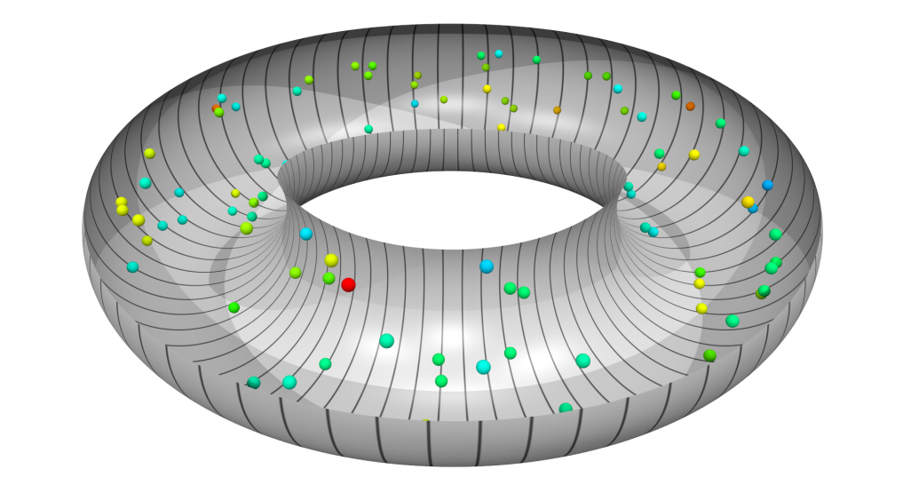
A Particle-In-Cell simulation from the Gyrokinetic Toroidal code (Princeton Plasma Physics laboratory) that simulates a plasma within a Tokomak fusion device. A sampling of some particles within the toroid are shown here colored according to their velocity with different supercomputing processor boundaries delineated by the toroidal subdivisions.

Slide 40
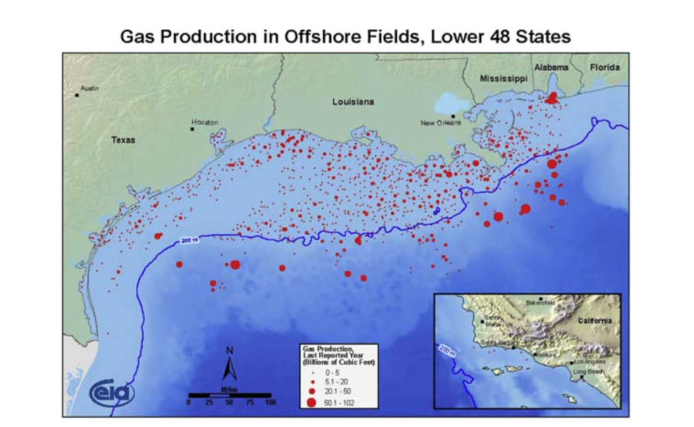
Researchers at BP use HPC to simulate sub-surface geologies using multi-dimensional analysis and characterization to accurately identify oil reservoirs.

Slide 41
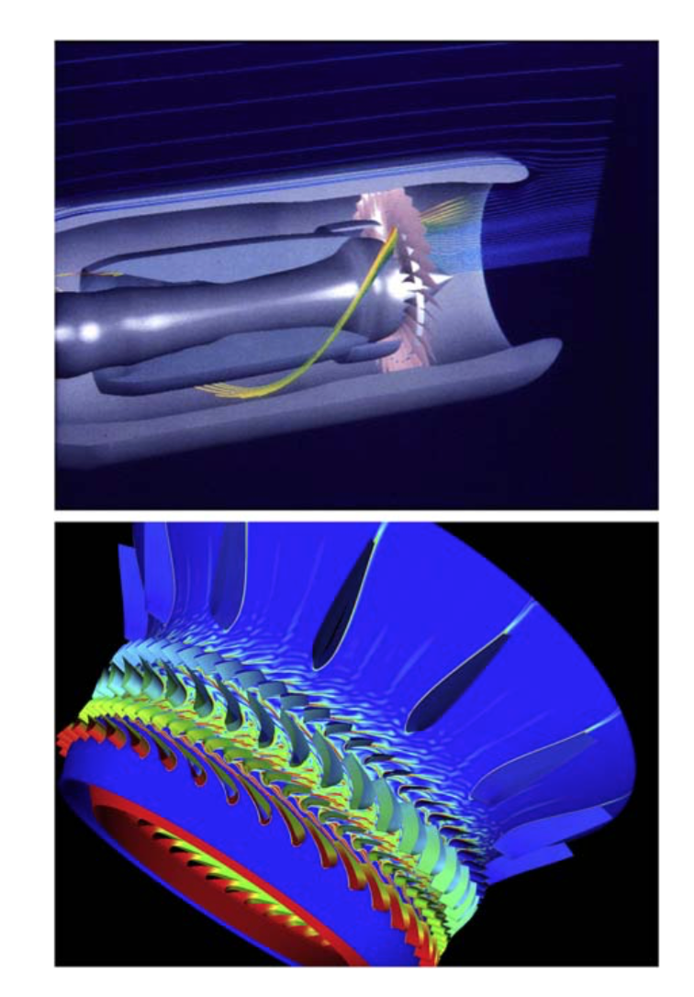
HPC is frequently used in high-fidelity virtual engine simulation and design. (Bottom) Researchers at NASA use HPC to simulate the design of next-generation turbines for both aviation and power production.

Slide 42
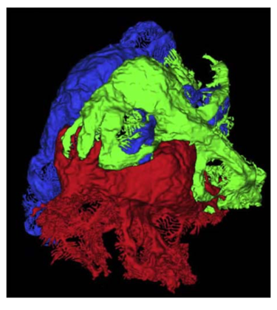
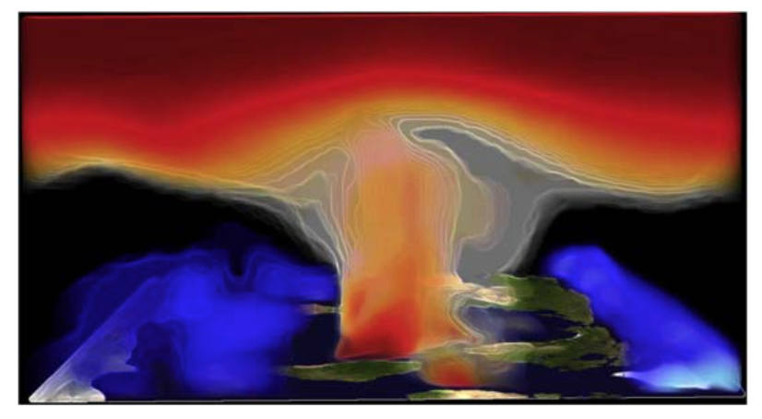
HPC is used to develop virtual models of kidney podocytes.
Researchers at Oak Ridge National Laboratory explore the advection of carbon dioxide in an atmospheric model.

Slide 43
Vertical Segments | Common Workflows
Financial Services | Fraud and Anomaly Detection, Backtesting for Algorithmic / proprietary trading, Risk Analytics
Oil and Gas | Seismic Processing, Interpretation , Reservoir modeling
Manufacturing | Materials Simulation, Structural Simulations (Noise/Vibration/Hardness & Crash), Aerodynamics simulations, Design space exploration, Thermal simulations and many more
Life Sciences | Molecular Dynamics, Drug discovery, Virtual modeling, gnome sequencing and many more.
Earth Sciences | Atmospheric modeling, Hydrodynamic modeling, Ice Modeling, Coupled Climate Modeling

Slide 44
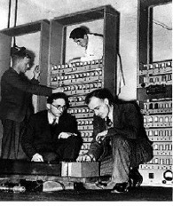
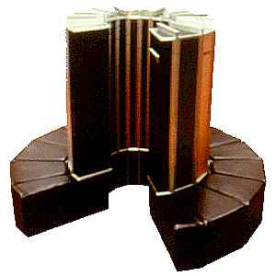
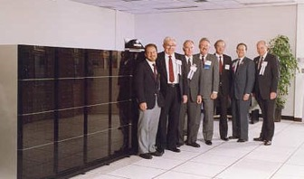
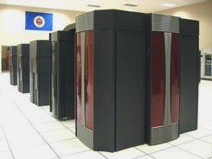
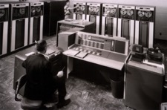
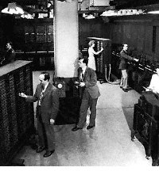
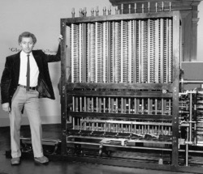
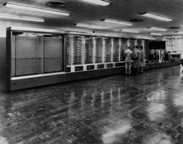
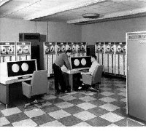
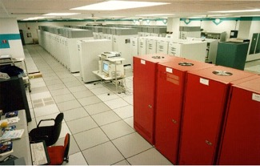
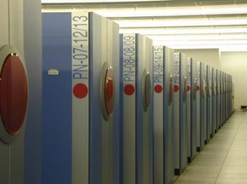
History of HPC
1959
IBM 7094
1976
Cray 1
1991
Intel Delta
1996
T3E
2003
Cray X1
2009
Cray XT5
1949
Edsac
1
10³
10⁶
10⁹
10¹²
10¹⁵
One OPS
KiloOPS
MegaOPS
GigaOPS
TeraOPS
PetaOPS
1823
Babbage Difference Engine
1951
Univac 1
1964
CDC 6600
1982
Cray XMP
1988
Cray YMP
1997
ASCI Red
2001
Earth Simulator
2006
BlueGene/L
1943
Harvard Mark 1

Slide 45
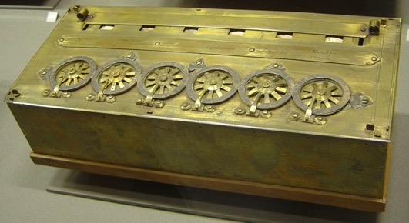
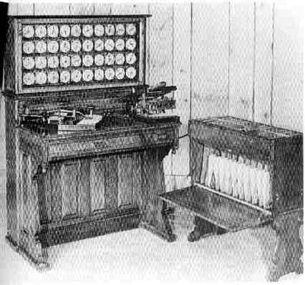
Epoch I: Mechanical Calculating
1650 – 1950
Enabling technology
Tally sticks, beads
Gears, carry mechanism
Punched cards
Fundamental Concepts
Storage of numeric values
Method of arithmetic ops
Instruction sequence control
Accomplishments
Abacus, Pascaline, Jacquard Loom
Design: Babbage Analytical Engine
1890 U.S. census
Tabulator, Harvard Mark 1, ENIAC, Colossus
1 ops performance
Pascal’s calculator
Hollerith’s punched card tabulator

Slide 46
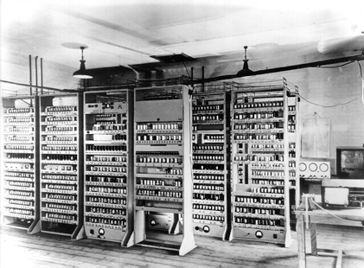
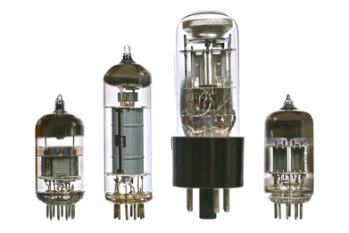
Epoch II: von Neumann Architecture
1950 – 1960
Enabling Technology
Vacuum Tube
Signal amplification
Logic circuits
Flip-flop bit latch
Memory
Mercury delay line
Electro-static Williams tube
Magnetic cores
EDSAC, 1949
Fundamental Concepts
Von Neumann execution model
Turing computability
Boolean logic
Bit identified by Shannon
Accomplishments
KIPS performance
EDSAC, UNIVAC, Whirlwind, IBM 709

Slide 47
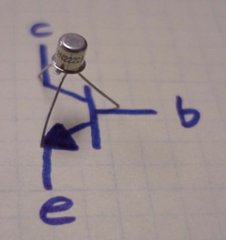
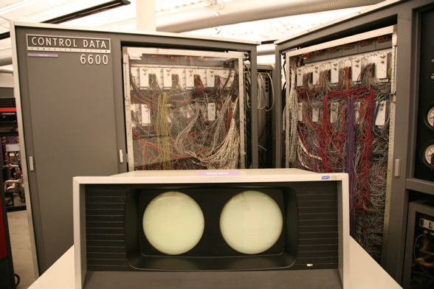
Epoch III: Instruction Parallelism
Enabling technology
Transistor
Semiconductor: Germanium, Silicon
Fundamental Concepts
Improve clock rate through technology
Parallelism: Overlapped instruction execution
Accomplishments
Replace vacuum tube with transistor
Architecture parallelism exploited
CDC 6600 delivered 1964 to Los Alamos
1 Megaflops peak performance
CDC 6600

Slide 48
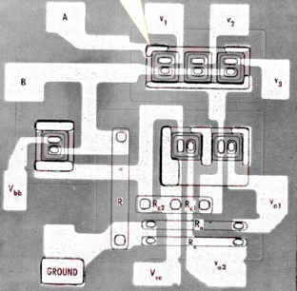
Epoch IV: Vector Processing
1975 – 1980
Enabling Technology
SSI (Small Scale Integration), MSI (Medium Scale Integration)
Integrated Circuits: RTL, DTL, TTL, ECL
Fundamental Concepts
Increased clock rate
Technology
Logic design – small functional steps
Pipeline structures
Vector execution model
Accomplishments
Cray 1
80 MHz clock rate
136 Megaflops Peak Performance
CRAY-1

Slide 49
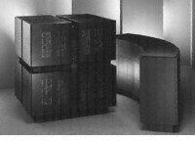
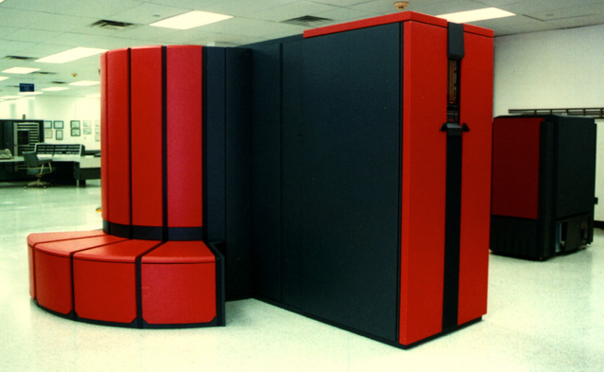
Epoch V: SIMD-array/PVP
1980 – 1990
Enabling technology
LSI (Large Scale Integration)
Fundamental Concepts
Single Instruction Stream, Multiple Data
Medium grained parallelism
Parallel Vector Processing (PVP)
Array of numeric processors under single control stream
Accomplishments
Gigaflops range performance
Maspar, Cray XMP, YMP, …

Slide 50
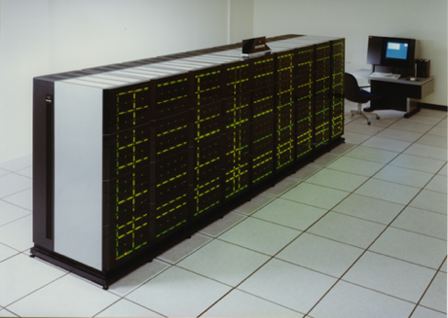
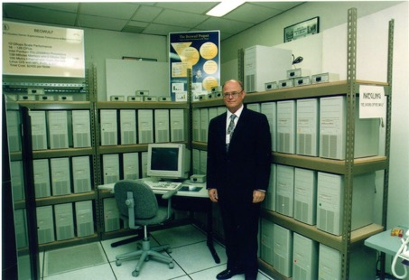
Epoch VI: CSP
1990 - 2005
Enabling Technology
VLSI (Very Large Scale Integration)
32-bit/64-bit Microprocessor (the Killer Micro)
System Area Network (SAN)
Fundamental Concepts
Communicating Sequential Processing (CSP)
Distributed memory, message passing
Bulk Synchronous Parallel (BSP)
Accomplishments
Commodity clusters and MPPs
Dominates for two decades
From 10s of Gigaflops to Teraflops to Petaflops performance
Intel Touchstone Delta
Beowulf Commodity Cluster

Slide 51

Epoch VII: Multicore/Heterogeneous
2005 - 2020
Enabling Technology
Multi-core
Fundamental Concepts
Hybrid execution
Heavy-weight nodes
Accomplishments
Fastest computers in the world
Improved energy efficiency
Hybrid programming interfaces
Cray/ORNL Titan
NUDT Tianhe-2

Slide 52
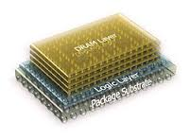
Epoch VIII: Exascale
2020 - 2030
Enabling Technology
3-D die stacking
Optical inter/intra socket networking
End of Moore’s Law
Processor-in-Memory (PIM)
Fundamental Concepts
Innovative execution models
Dynamic adaptive resource management
Message-driven computation
Multi-threading
Accomplishments
Billion-way parallelism
Energy <20pJ/op
Runtime system software
3-D Die Stacking

Slide 53
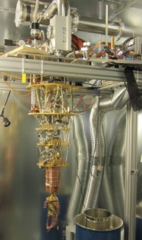
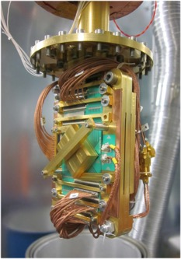
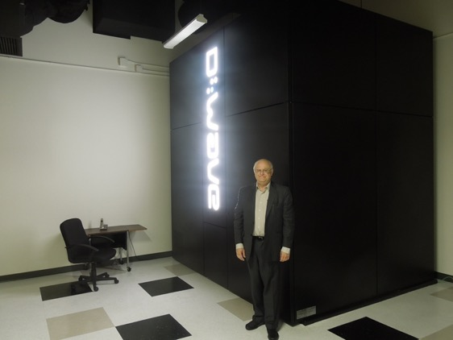
Epoch IX: Quantum ?
Beyond 2030
Enabling Technology
Cryogenics
Josephson Junctions
Graphene and NCT
Fundamental Concepts
Quantum Mechanics
Accomplishments
A few qubits
Adiabatic switching
Algorithms
Witnessing entanglement
Qubits
D-Wave Quantum Computer

Slide 54
Parallel Computer Architecture

Slide 55
Opening Remarks
This lecture is an introduction to supercomputer architecture
Major parameters, classes, and system level
Architecture exploits device technology to deliver its innate computation performance potential
Structures and system organization
Semantics of operation and memory (instruction set architecture, ISA)
Between device technology and architecture is circuit design
Circuit design converts devices to logic gates and higher level logical structures (e.g. multiplexers, adders)
but this is outside the scope of this course.
We will assume basic logic abstraction with characterizing properties:
Functional behavior (the logical operation it performs)
Switching speed
Propagation delay or latency
Size and power

Slide 56
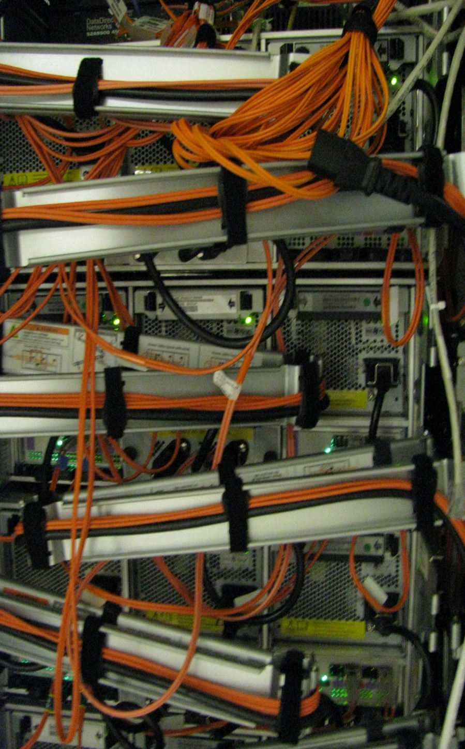
Topics
The HPC System Stack
What is Computer Architecture
Review Performance Factors and Metrics
MIMD class HPC Architecture
An Introduction to Shared Memory Multiprocessors
Coarse-grained MIMD Processing – MPPs
SIMD class HPC Architecture
Very Fine-grained Vector Processing and PVPs
SIMD array and SPMD
Current generation multicore and heterogeneous architecture

Slide 57
HPC System Stack
Science Problems : Environmental Modeling, Physics, Computational Chemistry, etc.
Application : Coastal Modeling, Black hole simulations, etc.
Algorithms : PDE, Gaussian Elimination, 12 Dwarves, etc.
Program Source Code
Programming Languages: Fortran, C, C++ , UPC, Fortress, X10, etc.
Compilers : Intel C/C++/Fortran Compilers, PGI C/C++/Fortran, IBM XLC, XLC++, XLF, etc.
Runtime Systems : Java Runtime, MPI etc.
Model of Computation
Operating Systems : Linux, Unix, AIX etc.
Systems Architecture : Vector, SIMD array, MPP, Commodity Cluster
Firmware : Motherboard chipset, BIOS, NIC drivers,
Microarchitectures : Intel/AMD x86 IBM Power 8/9
Logic Design : RTL
Circuit Design : ASIC, FPGA, Custom VLSI
Device Technology : NMOS, CMOS, TTL, Optical

Slide 58
Topics
The HPC System Stack
What is Computer Architecture
Review Performance Factors and Metrics
MIMD class HPC Architecture
An Introduction to Shared Memory Multiprocessors
Coarse-grained MIMD Processing – MPPs
SIMD class HPC Architecture
Very Fine-grained Vector Processing and PVPs
SIMD array and SPMD
Current generation multicore and heterogeneous architectures

Slide 59
Computer Architecture
Structure
Functional elements
Organization and balance
Interconnect and Data flow paths
Semantics
Meaning of the logical constructs
Primitive data types
Manifest as Instruction Set Architecture abstract layer
Mechanisms
Primitive functions that are usually implemented in hardware or sometimes firmware
Determines preferred actions and sequences
Enables efficiency and scalability
Policy
Approach and priorities to accomplishing a goal
e.g., cache replacement policy

Slide 60
Structure
Functional elements
The form of functional elements made up of more primitive logical modules
e.g. vector arithmetic unit comprising a pipeline of simple stages
Organization and balance
Number of major elements of different types
Hierarchy of collections of elements
Data flow
Interconnection of functional, state, and communication elements
Control of dataflow paths determines actions of processor and system

Slide 61
Semantics
Meaning of the logical constructs
Basic operations that can be performed on data
Primitive data types
What collections of bits (e.g. word) means
Defines actions that can be performed on binary strings
Instruction Set Architecture
Defined set of actions that can be performed and data object on which they can be applied
Encoding of binary strings to represent distinct instructions
Parallel control constructs
Hardware implemented : vector operations,
Software implemented : MPI libraries

Slide 62
Mechanisms
Primitive functions that are usually implemented in hardware or sometimes firmware
Lower level than instruction set operations
Multiple such mechanisms contribute to execution of operation
Determines preferred actions and sequences
Usually time effective primitives
Usually widely used by many instructions
Enables efficiency and scalability
Establishes basic performance properties of machine
Examples
Basic arithmetic and logic unit functions
Thread context switching
TLB (Translation Lookaside Buffer) address translation
Cache line replacement
Branch prediction

Slide 63
Policy
Hardware architecture policies
Decision of ordering or allocation dependent on criteria
Not all machine decisions are visible to the ISA of the system
Not all machine choices are available to the name space of the operands
Examples
Cache structure, size, and speed
Cache replacement policies
Order of operation execution
Branch prediction
Allocation of shared resources
Network routers
Software system management policies
Scheduling,
Data allocation : partitioning of a problem

Slide 64
Topics
The HPC System Stack
What is Computer Architecture
Review Performance Factors and Metrics
MIMD class HPC Architecture
An Introduction to Shared Memory Multiprocessors
Coarse-grained MIMD Processing – MPPs
SIMD class HPC Architecture
Very Fine-grained Vector Processing and PVPs
SIMD array and SPMD
Current generation multicore and heterogeneous architectures

Slide 65
Performance Factors: Technology Speed
Latencies
Logic latency time: time to go between logic gates
Processor to memory access latency: wire from RAM to CPU are kept same to keep same latency for each RAM
Memory access time
Network latency
Cycle Times
Logic switching speed
On-chip clock speed (clock cycle time)
Memory cycle time
Throughput
On-chip data transfer rate
Instructions per cycle
Network data rate
Granularity
Logic density
Memory density
Task Size
Packet Size

Slide 66
Machine Parameters affecting Performance
Peak floating point performance
Main memory capacity
Bi-section bandwidth
I/O bandwidth
Secondary storage capacity
Organization
Class of system
# nodes
# processors per node
Accelerators
Network topology
Control strategy
MIMD
Vector, PVP
SIMD
SPMD
Courtesy of Bill Tang, Princeton

Slide 67
Performance Factors: Parallelism
Fully independent processing elements operating concurrently on separate tasks
Coarse grained
Communicating Sequential Processes (CSP),
Single Program Multiple Data stream (SPMD)
Instruction Level Parallelism (ILP)
Fine grained
Single instruction performs multiple operations
Pipelining
Fine grained
Overlapping sequential operations in execution pipeline
Vector pipelines
SIMD operations
Fine / Medium grained
Single Instruction stream, Multiple Data stream
ALU arrays
Overlapping of computation and communication
Fine / Medium grained
Asynchronous
Prefetching
Multithreading
Medium grained
Separate instruction streams serve single processor

Slide 68
Sources of Performance Degradation (SLOW)
Starvation
Not enough work to do among distributed resources
Insufficient parallelism
Inadequate load balancing
e.g. : Amdahl's law
Latency
Time required for response of access to remote data or services
Waiting for access to memory or other parts of the system
e.g. : Local memory access, Network communication
Overhead
Extra work that has to be done to manage program concurrency and parallel resources the real work you want to perform
Critical-path work for management of concurrent tasks and parallel resources not required for sequential execution
e.g. : Synchronization and scheduling
Waiting for Contention
Delays due to conflicts for use of shared resources.
e.g. : Memory bank conflicts, shared network channels

Slide 69
Parallel Structures & Performance Issues
Pipelining
Vector processing
Execution pipeline
Performance Issues:
Pipelining increases throughput : More operations per unit time
Pipelining increases latency time : Operation on single operand pair can take longer than non-pipelined functional unit
Multiple Arithmetic Units
Instruction level parallelism
Systolic arrays
Performance Issues:
Increases peak performance
Requires application instruction level parallelism
Average usually significantly lower than peak

Slide 70
Parallel Structures & Performance Issues
Multiple processors
MIMD: Separate control
SIMD: Single controller
Multicore
Accelerators
Performance Issues: Multiple processors require overhead operations
Synchronization
Communications
Possibly cache Coherence

Slide 71
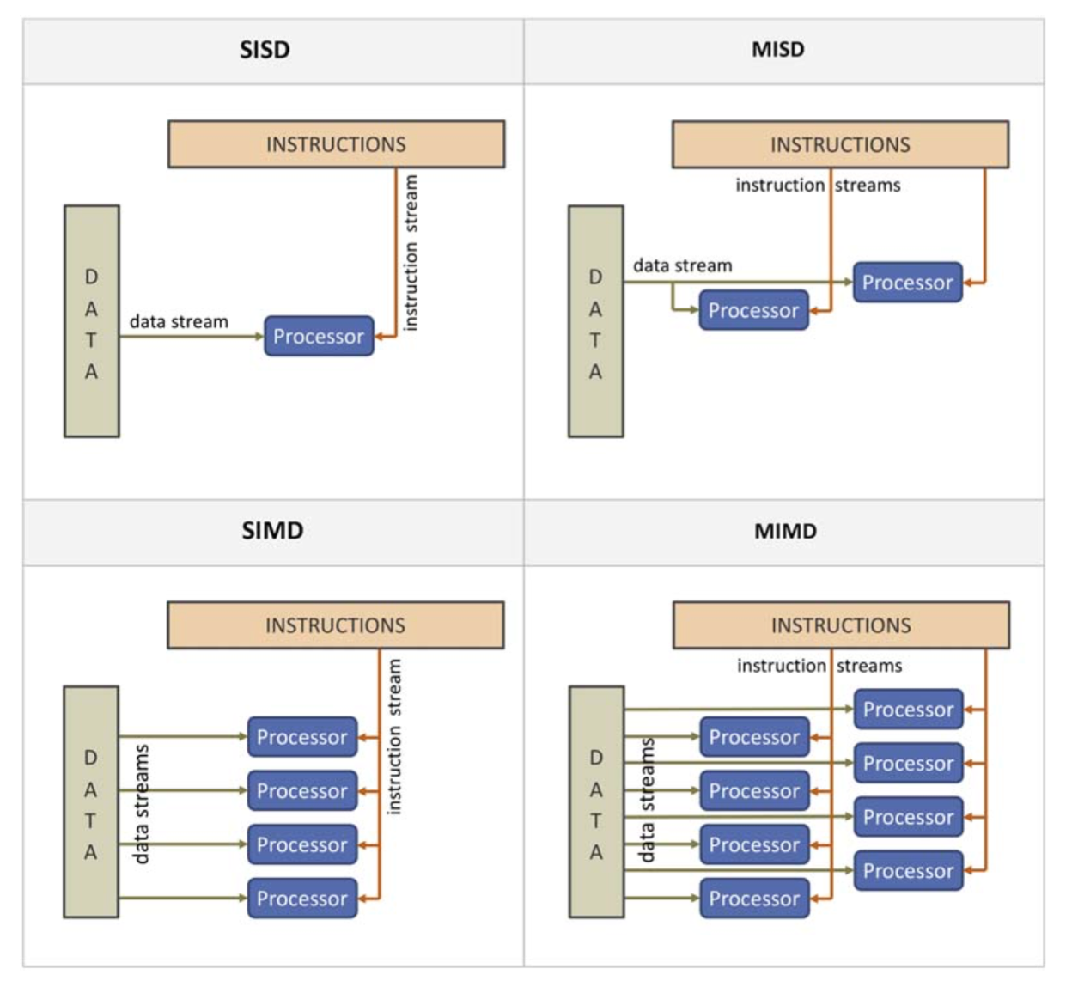
Flynn’s taxonomy. MIMD, multiple instruction stream, multiple data stream; MISD, multiple instruction stream, single data stream; SIMD, single instruction stream, multiple data stream; SISD, single instruction stream, single data stream.

Slide 72
Scalability
The ability to deliver proportionally greater sustained performance through increased system resources
Strong Scaling
Fixed size application problem
Application size remains constant with increase in system size
Weak Scaling
Variable size application problem
Application size scales proportionally with system size
Capability computing
in most pure form: strong scaling
Marketing claims tend toward this class
Capacity computing
Throughput computing
Includes job-stream workloads
In most simple form: weak scaling
Cooperative computing
Interacting and coordinating concurrent processes
Not a widely used term
Also: “coordinated computing”

Slide 73
Performance Metrics
Peak floating point operations per second (flops)
Peak instructions per second (ips)
Sustained throughput
Average performance over a period of time
flops, Mflops, Gflops, Tflops, Pflops
flops, Megaflops, Gigaflops, Teraflops, Petaflops
ips, Mips, ops, Mops …
Cycles per instruction
cpi
Alternatively: instructions per cycle, ipc
Memory access latency
cycles per second
Memory access bandwidth
bytes per second (Bps)
bits per second (bps)
or Gigabytes per second, GBps, GB/s
Bi-section bandwidth
bytes per second
Notes:
Floating point – IEEE754
Single precision, double precision

Slide 74

Practical Constraints and Limitations
Cost
Deployment
Operational support
Power
Energy required to run the computer
Energy for support facilities
Energy for cooling (remove heat from machine)
Size
Floor space
Access way for power and signal cabling
Reliability
One factor of availability
Generality
How good is it across a range of problems
Usability
How hard is it to program and manage
Notes:
Benchmark?

Slide 75
Topics
The HPC System Stack
What is Computer Architecture
Review Performance Factors and Metrics
MIMD class HPC Architecture
An Introduction to Shared Memory Multiprocessors
Coarse-grained MIMD Processing – MPPs
SIMD class HPC Architecture
Very Fine-grained Vector Processing and PVPs
SIMD array and SPMD
Current generation multicore and heterogeneous architectures

Slide 76

Basic Uni-processor Architecture elements
I/O Interface
Memory Interface
Cache hierarchy
Register Sets
Control
Execution pipeline
Arithmetic Logic Units

Slide 77
Multiprocessor
A general class of system
Integrates multiple processors in to an interconnected ensemble
MIMD: Multiple Instruction Stream Multiple Data Stream
Different memory models
Distributed memory
Nodes support separate address spaces
Shared memory
Symmetric multiprocessor
UMA – uniform memory access
Cache coherent
Distributed shared memory
NUMA – non uniform memory access
Cache coherent
PGAS
Partitioned global address space
NUMA
Not cache coherence
Hybrid : Ensemble of distributed shared memory nodes
Massively Parallel Processor, MPP

Slide 78


Massively Parallel Processor
MPP
General class of large scale multiprocessor
Represents largest systems
IBM BG/L
Cray XT3
Distinguished by memory strategy
Distributed memory
Distributed shared memory
Cache coherent
Partitioned global address space
Custom interconnect network
Potentially heterogeneous
May incorporate accelerator to boost peak performance

Slide 79

DM-MPP

Slide 80


Commodity Clusters
Distributed Memory systems
Superior performance to cost
Dominant parallel systems architecture on the Top 500 List
Combines off the shelf systems in scalable structure
Employs commercial high-bandwidth networks for integration
Message Passing programming model used (e.g. MPI)
First cluster on Top500 : Berkley Now, 1997

Slide 81
Topics
The HPC System Stack
What is Computer Architecture
Review Performance Factors and Metrics
MIMD class HPC Architecture
An Introduction to Shared Memory Multiprocessors
Coarse-grained MIMD Processing – MPPs
SIMD class HPC Architecture
Very Fine-grained Vector Processing and PVPs
SIMD array and SPMD
Current generation multicore and heterogeneous architectures

Slide 82
Pipeline Structures
Partitioning of functional unit into a sequence of stages
Execution time of each stage is < that of the original unit
Total time through sequence of stages is usually > that of the original unit
Pipeline permits overlapping of multiple operations
At any one time: each stage is performing different operation
# of operations being performed in parallel = # stages
Performance
Pipeline increments at clock rate of slowest pipeline stage
Response time for an operation is product of # stages and clock cycle time
Throughput = clock rate
i.e. one operation result per clock cycle of pipeline
Pipeline structures employed in many parts of a computer architecture
to enable high throughput in the presence of high latency
enable faster clock rates

Slide 83
Pipeline: Concepts
T_{c}
t_{p}
T_{p}
Where :
T_{c} is the Logic Latency
T_{p} is the aggregated pipeline latency
t_{p} is the latency for each pipelined step

Slide 84
Vector Processors
Supports fine grained data parallel semantics
Many instances of same operation performed concurrently under same control element
Operates on vector data structures rather than single scalar values
Vector-scalar operations
Scale a vector by a scalar factor (multiply each vector element by scalar)
Inter-vector operations
e.g., Pair wise multiplies
Intra-vector operation
Reduction operators
e.g., sum all elements of a vector
Exploits pipeline structure
Arithmetic units
Vector registers
Overlap of memory banks access cycles
Overlap of communication with computation
Limited scaling – upper bound on number of pipeline stages

Slide 85
Vector Pipeline Architecture
Vector Register (N_{R})
High speed memory bus
t_{a} : time for memory access
Vector ALU (N_{S} Stages)
M₁
M₂
M_{N}
Where :
t_{a} is the time for memory access
t_{s} is the startup time
T_{MV} is the combined time for Memory Vector
P_{M} is the memory performance
t_{c} is the ALU clock time of each step

Slide 86




Cray 1
First announced in 1975-6
80 MHz Clock rate
Theoretical peak performance (160 MIPS), average performance 136 megaflops, vector optimized peak performance 150 megaflops
1-million 64 bit words of high speed memory
Manufactured by Cray Research Inc.
First Customer was National Center for Atmospheric Research (NCAR) for 8.86 million dollars.
The Cray 1 System
Cray 1 logic boards
src : http://en.wikipedia.org/wiki/Cray-1

Slide 87
Parallel-Vector-Processors: PVP
Combines strengths of vector and MPP
Efficiency of vector processing
Capability computing
Scalability of massively parallel processing
Capacity and cooperative computing
Two levels of parallelism
Ultra fine grain vector parallelism with vector pipelining
Medium to coarse-grain processor
Memory model
Alternative ways of organizing memory & address space
Distributed memory
Shared memory within node of multiple vector processors
Fragmented or decoupled address space between nodes
Partitioned global address space
Globally accessible address space
No cache coherence between nodes

Slide 88

PVP (e.g. Cray- XMP)

Slide 89
SIMD Array
SIMD semantics
Single Instruction stream Multiple Data stream
Data set partitioned in to blocks upon which
One or two dimensions (vectors or matrices)
Each data block is processed separately
Each data block is controlled by same instruction sequence
Data exchange cycle
SIMD Parallel Structure
Node Array of arithmetic units, each coupled to local memory
Interconnect network for global data exchange
Single controller to issue instructions to array nodes
Early systems broadcast one instruction at a time
Modern systems point to sequence of cached instructions
SPMD
Single Program Multiple Data Stream
Microprocessor based system where each node runs same program

Slide 90
Simplified SIMD Diagram
M_{Dij}
Processing Element
Sequencer
. . .
Instruction Broadcast
Bus
00
01
02
0n
M_{I}
10
11
12
1n
M_{D}
20
21
22
2n
Switch
. . .
. . .
. . . . .
n0
nn
Control Processor
Data Processors

Slide 91


CM- 2
CM-2 General Specifications :
Processors 65,536
Memory 512 Mbytes
Memory Bandwidth 300Gbits/Sec
I/O Channels 8 Capacity per Channel 40 Mbytes/Sec Max.
Transfer Rate 320 Mbytes/Sec
Performance in excess of 2500 MIPS
Floating Point performance in excess of 2.5 GFlops
DataVault Specifications :
Storage Capacity 5 or 10 Gbytes
I/O Interfaces 2 Transfer Rate,
Burst 40 Mbytes/Sec Max.
Aggregate Rate 320 Mbytes/Sec
Originated at MIT, by Danny Hillis
Commercialized at Thinking Machines Corp.
src : http://www.svisions.com/sv/cm-dv.html

Slide 92
Introduction to SMP
Symmetric Multiprocessor
Building block for large MPP
Multiple processors
2 to 32 processors
Now Multicore
Uniform Memory Access (UMA) shared memory
Every processor has equal access in equal time to all banks of the main memory
Cache coherent
Multiple copies of variable maintained consistent by hardware

Slide 93

SMP- UMA
src : http://www.svisions.com/sv/cm-dv.html

Slide 94
SMP Node Diagram
MP
MP
MP
MP
Legend :
MP : MicroProcessor
L1,L2,L3 : Caches
M1.. : Memory Banks
S : Storage
NIC : Network Interface Card
L1
L1
L1
L1
L2
L2
L2
L2
L3
L3
M1
M1
M_{n-1}
S
Controller
PCI-e
JTAG
S
Ethernet
Peripherals
NIC
NIC
USB

Slide 95

DSM- NUMA

Slide 96
Challenges to Computer Architecture
Expose and exploit extreme fine-grain parallelism
Possibly multi-billion-way (for Exascale)
Data structure-driven (use meta-data parallelism)
State storage takes up much more space than logic
1:1 flops/byte ratio infeasible
Memory access bandwidth is the critical resource
Latency
can approach a million cycles (10,000 or more cycles, typical)
All actions are local
Contention due to inadequate bandwidth
Overhead for fine grain parallelism must be very small
or system can not scale
One consequence is that global barrier synchronization is untenable
Power consumption
Reliability
Very high replication of elements
Uncertain fault distribution
Fault tolerance essential for good yield
Design complexity
Impacts development time, testing, power, and reliability

Slide 97
Topics
The HPC System Stack
What is Computer Architecture
Review Performance Factors and Metrics
MIMD class HPC Architecture
An Introduction to Shared Memory Multiprocessors
Coarse-grained MIMD Processing – MPPs
SIMD class HPC Architecture
Very Fine-grained Vector Processing and PVPs
SIMD array and SPMD
Current generation multicore and heterogeneous architectures

Slide 98
Multi-Core
Motivation for Multi-Core
Exploits increased feature-size and density
Increases functional units per chip (spatial efficiency)
Limits energy consumption per operation
Constrains growth in processor complexity
Challenges resulting from multi-core
Relies on effective exploitation of multiple-thread parallelism
Need for parallel computing model and parallel programming model
Aggravates memory wall
Memory bandwidth
Way to get data out of memory banks
Way to get data into multi-core processor array
Memory latency
Fragments L3 cache
Pins become strangle point
Rate of pin growth projected to slow and flatten
Rate of bandwidth per pin (pair) projected to grow slowly
Requires mechanisms for efficient inter-processor coordination
Synchronization
Mutual exclusion
Context switching

Slide 99

Amdahl’s Law
T_{O}
start
end
T_{A}
T_{F}
start
end
T_{F}/g

